Slide 1

WAY TO ENTERPRISE
Java Basics
VTI ACADEMY
Author: duy.nguyenngoc1@vti.com.vn
March 2020

Slide 2
Agenda
3-layers Architecture
Comment template
Assignments
Copyright © VTI Academy All Rights Reserved

Slide 3
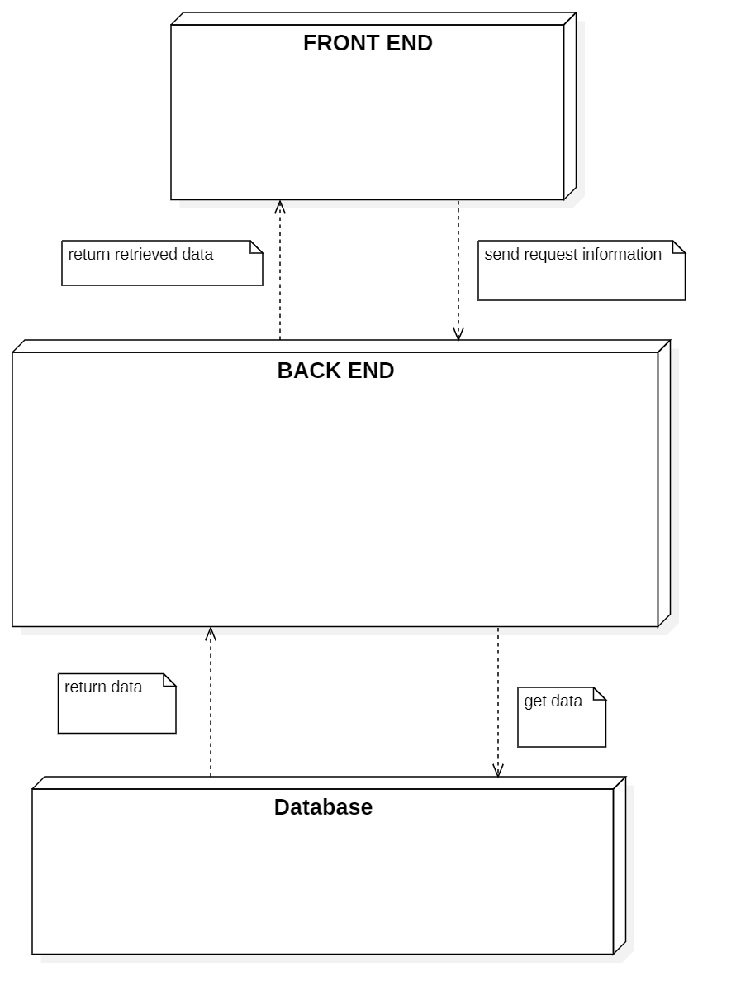
3-tiers Architecture

Slide 4
3-layers Architecture
Basic
Validation & Handling Exception
Handling business Logic

Slide 5
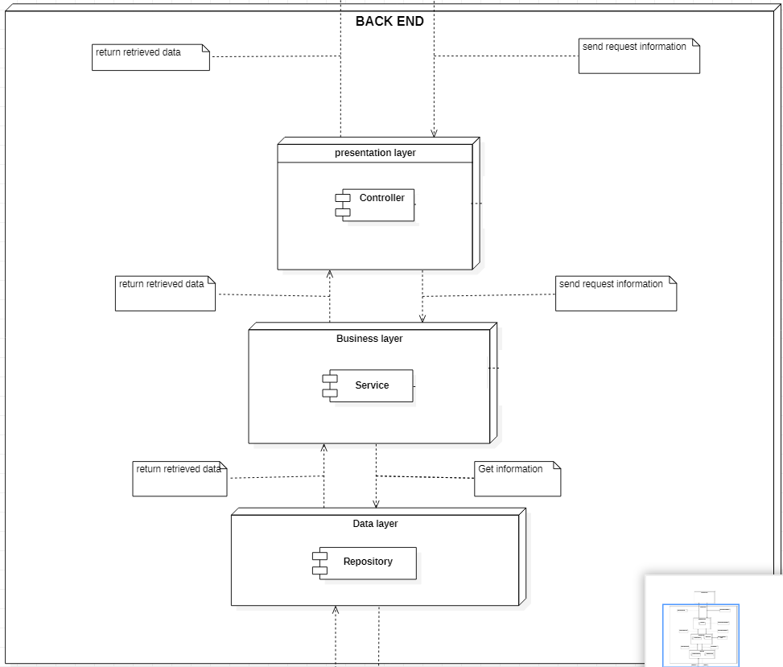
Basic

Slide 6
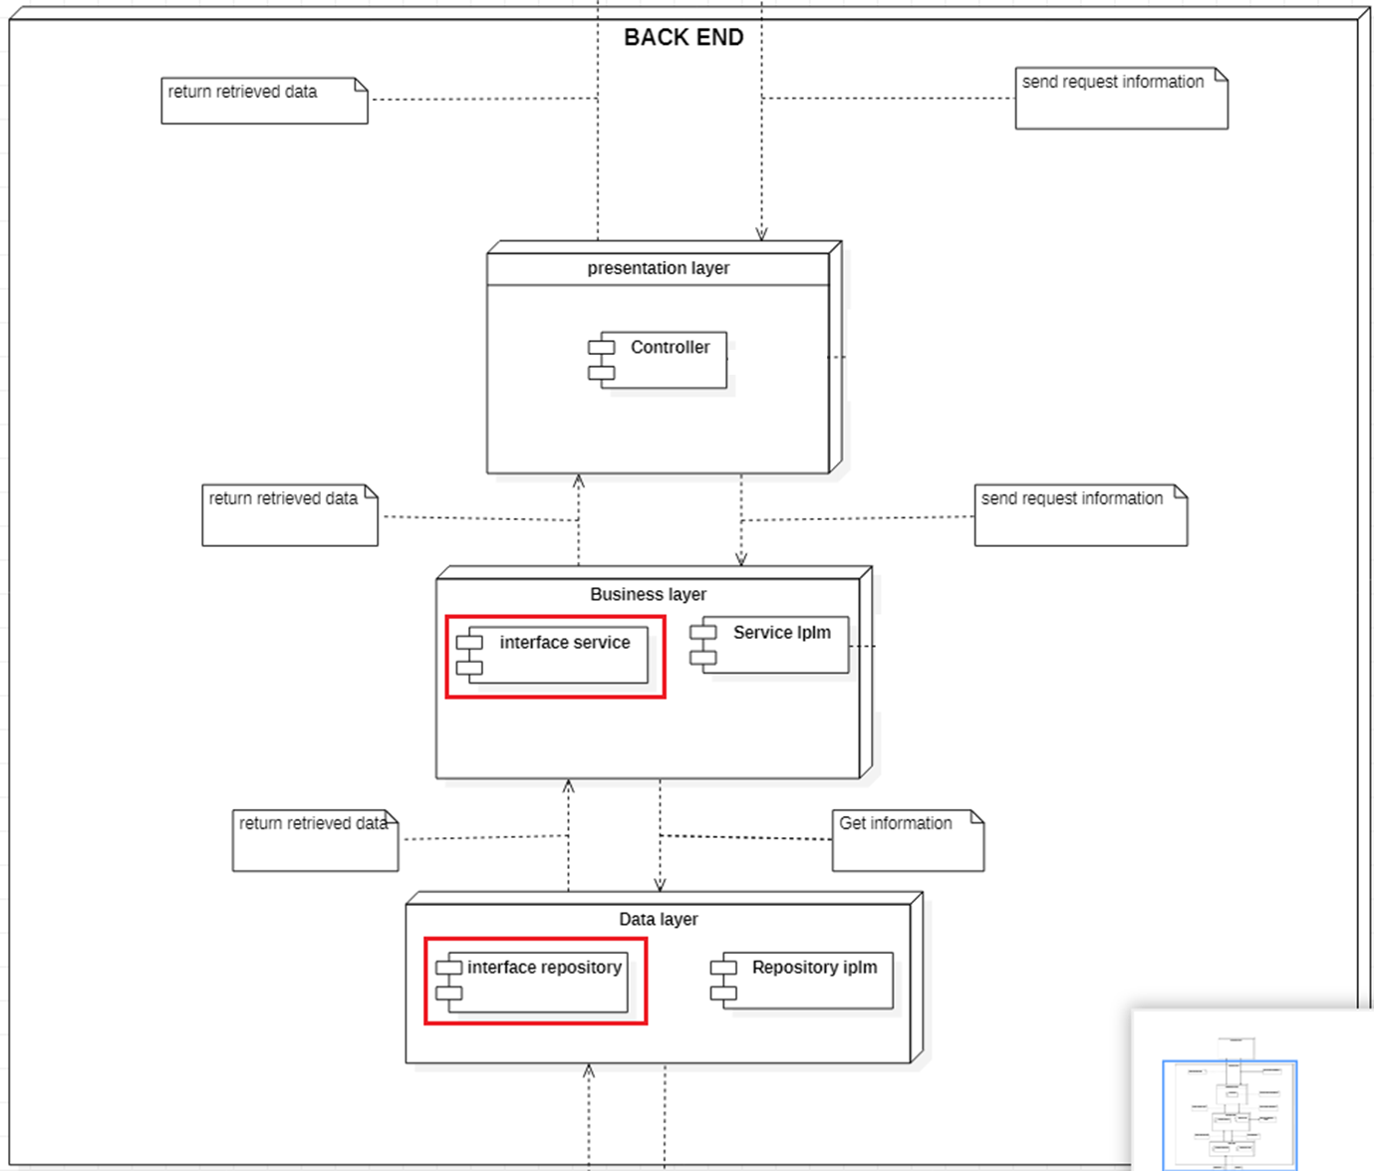
Basic (interface)

Slide 7
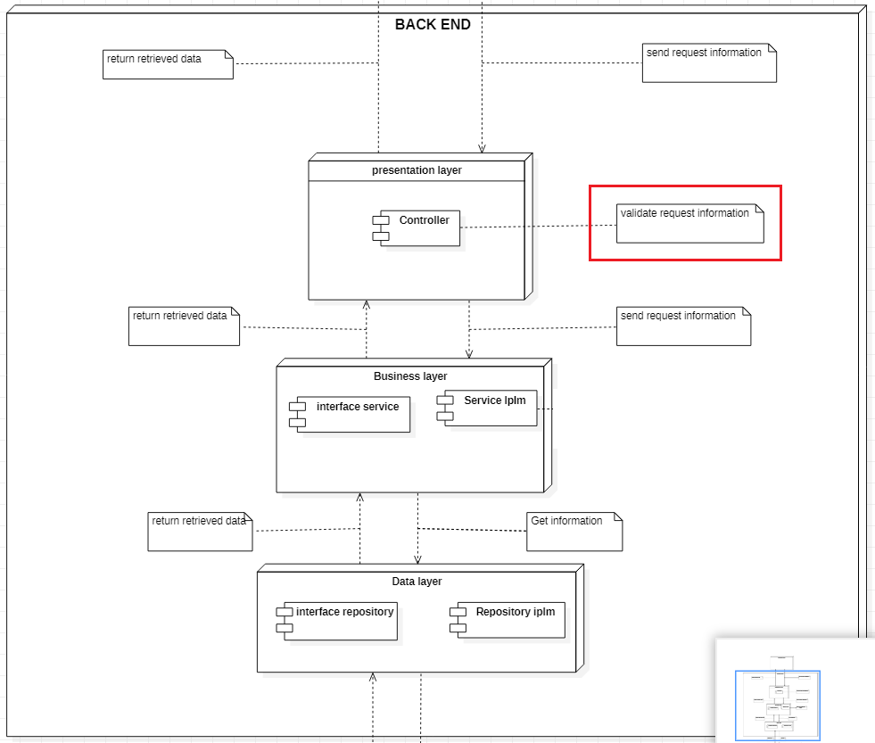
Validation & Handling Exception

Slide 8
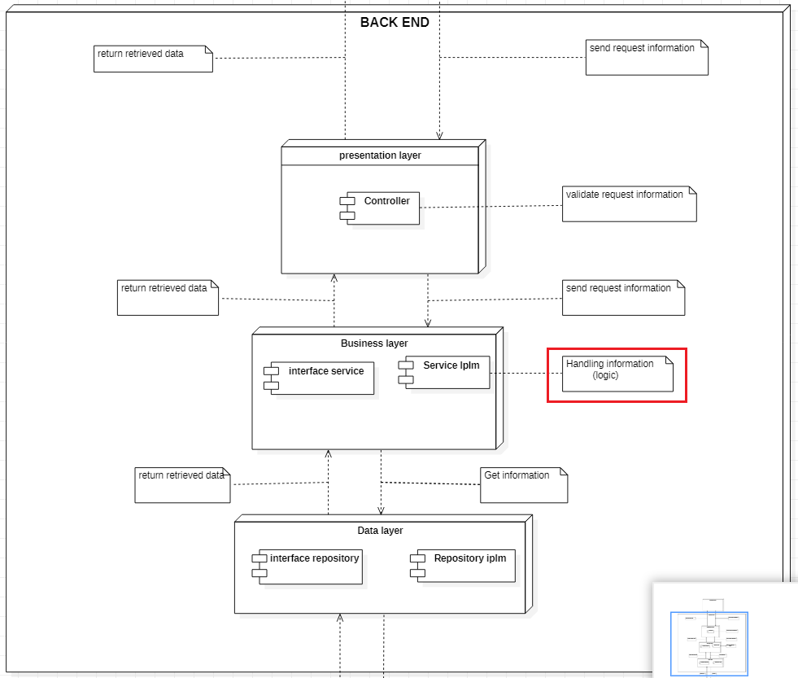
Handling business Logic

Slide 9
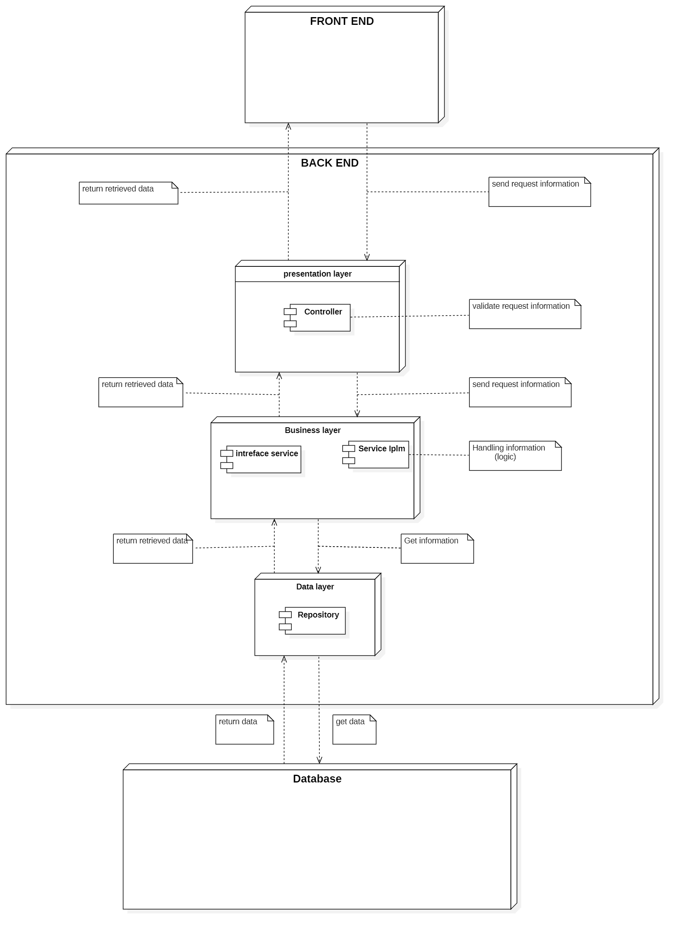
3-tiers Architecture

Slide 10
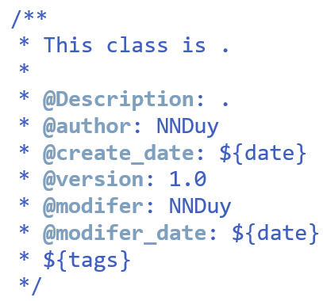
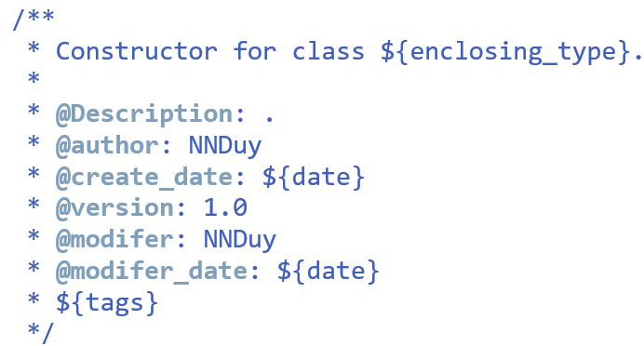
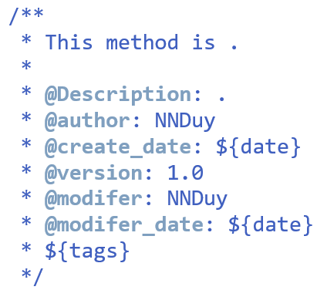
Comment template
Window → Preferences → Java → code Style → Code Templates
Shortcut: Alt + shift + j

Slide 11
Assignments 1

Slide 12
Assignments 2
Assignment for Testing System

Slide 13
Q & A
Copyright © VTI Academy All Rights Reserved

